Slide 1
DOENÇAS INFECCIOSAS E SISTEMA NERVOSO
Fernando P. Frassetto
MD, PhD, MBA

Slide 2
Declaração de Conflito de Interesse
Dr. Fernando P. Frassetto afirma não ter conflito
de interesse a declarar
Exigência da RDC Nº 96/08 da ANVISA

Slide 3

Agenda
. Conceitos Iniciais
. HIV/AIDS
. Arboviroses
. COVID-19 (incluindo long COVID)

Slide 4
Conceitos Iniciais
. Meningite: processo inflamatório entre pia-máter e aracnoide
. Encefalite: processo inflamatório parenquimatoso
Panencefalite - substância cinzenta e branca
Polioencefalite/Poliomielite - substância cinzenta
Da substância branca
. Ventriculite: processo inflamatório parietal/superficial em sistema ventricular
. Cerebrite: processo inflamatório purulento mal delimitado, não encapsulado (estágio de evolução de abscesso)

Slide 5
Conceitos Iniciais
. Infecções Virais
Associação ou não com imunossupressão (severidade)
Atuação viral direta, ativação inflamatória desregulada
Neuroinvasão x Neurotropismo – a presença de proteínas/material genético viral em amostras não comprova replicação

Slide 6
HIV

Slide 7
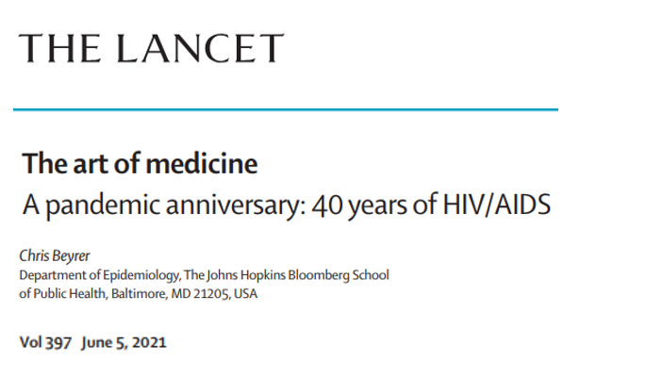
“Today, we find ourselves in a challenging period. The world’s attention had already moved away from HIV/AIDS as the disease shifted from almost certain death to a chronic, manageable condition (….)
The HIV/AIDS pandemic is far from over.”

Slide 8
HIV e Sistema Nervoso
Central
- Encefalite/Encefalopatia do HIV (HIVE)
Leucoencefalopatia do HIV (HIVL)
Leucoencefalopatia Multifocal Progressiva (LEMP/PML)
- Linfomas, Infecções oportunistas
Comorbidades – processos vasculares, toxicidade de drogas etc.
Encefalite CD8 HIV-associada
Periférico: miopatia, neuropatia

Slide 9
HIVE
Comprometimento neurocognitivo: HIV-associated neurocognitive disorder (HAND), HIV-associated dementia (HAD)
Necessidade de comprovação da presença do vírus (IHQ, HIS); sem inclusões
(Aparentemente) não infecta neurônios, mas apresentando perda neuronal

Slide 10
Achados Histopatológicos
Agregados de células inflamatórias - células gigantes multinucleadas, macrófagos (CD163+), nódulos de micróglia
Infiltrado inflamatório linfomononuclear perivascular (incluindo células gigantes) de intensidade variável (grau de imunossupressão)
Reatividade glial
Muitas vezes associada a leucoencefalopatia do HIV – dano da substância branca (desmielinização, principalmente centro semioval) secundário a resposta inflamatória
Notes:
Microglia geralmente não expressa CD163

Slide 11
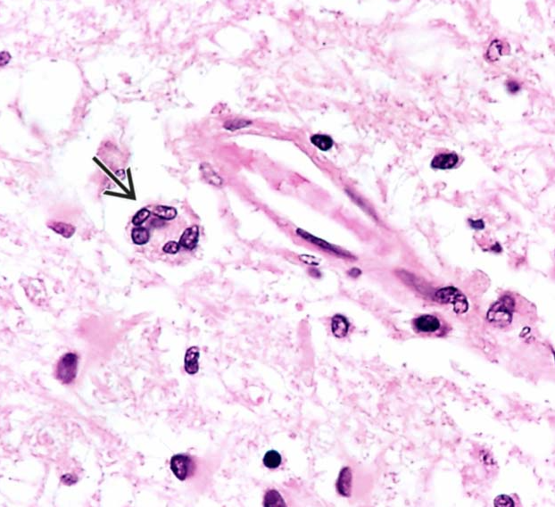
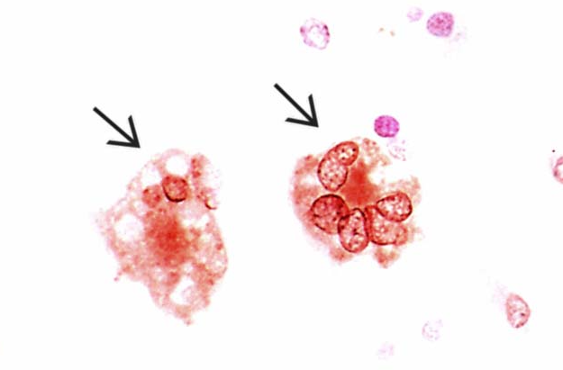
gp120
Diagnostic Pathology: Neuropathology, Third edition. 2022
Notes:
Infiltrado scant, pred perivasc;células gigantes. tambem pode ser gp4

Slide 12
LEMP/PML
Infecção de oligodendrócitos pelo vírus JC → perda celular, desmielinização
SV40 – reação IHQ cruzada
Pode estar associada a outros estados imunossupressivos

Slide 13
Achados Histopatológicos
Perda de oligodendrócitos
Desmielinização predominante em junção córtico-subcortical e pedúnculos cerebelares, podendo coalescer em grandes áreas
Injúria axonal
Macrófagos (diferencial com outras lesões macrophage-rich, incluindo neoplasias tratadas)
Astrócitos reativos, por vezes de aspecto bizarro e multinucleado (células de Creutzfeld)

Slide 14
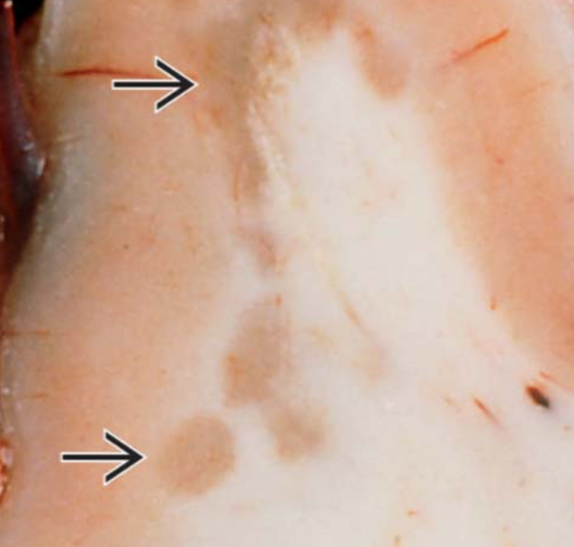
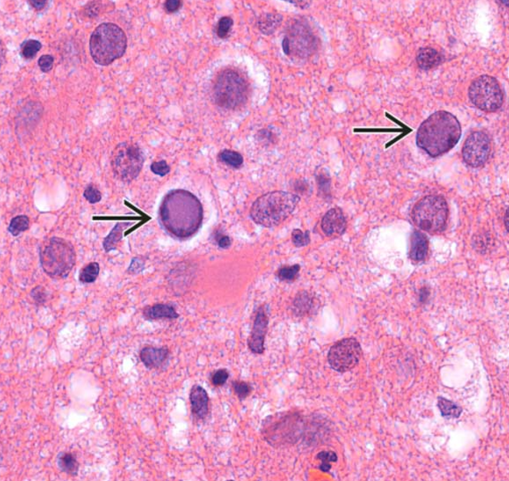
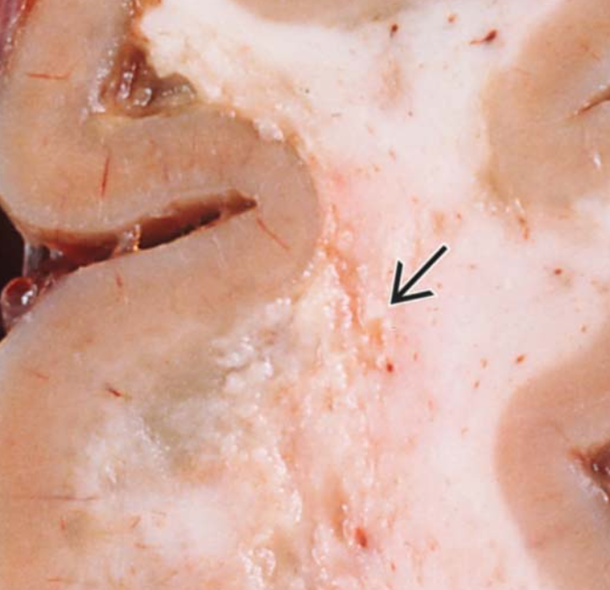
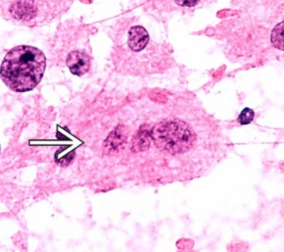
Diagnostic Pathology: Neuropathology, Third edition. 2022

Slide 15
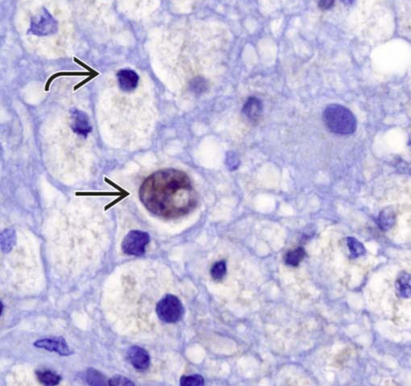
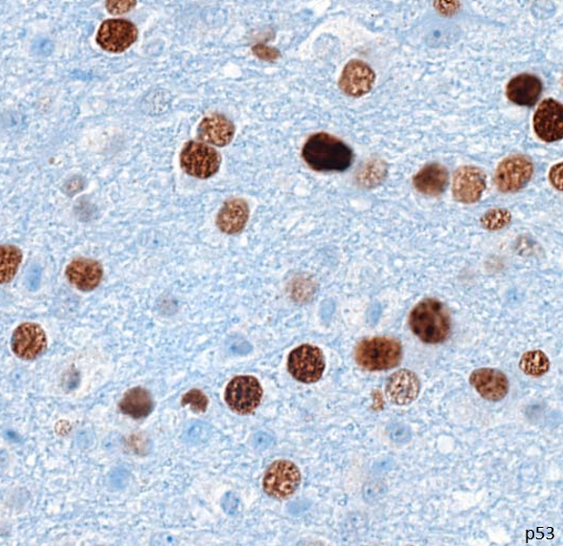
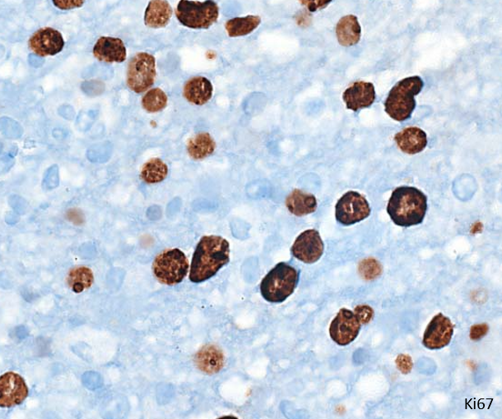
SV40
Diagnostic Pathology: Neuropathology, Third edition. 2022
Notes:
Oligos infectados
SV40 scant em lesão rica em macrófagos – DD!

Slide 16
Infecção de Neurônios por JCV
Neuronopatia de células granulares do cerebelo
Encefalopatia fatal/fulminante por JC

Slide 17
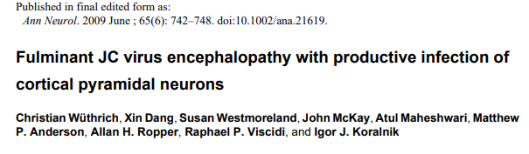
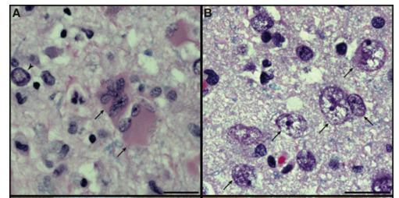
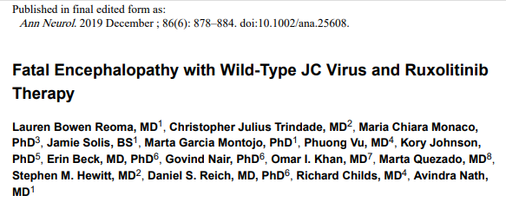
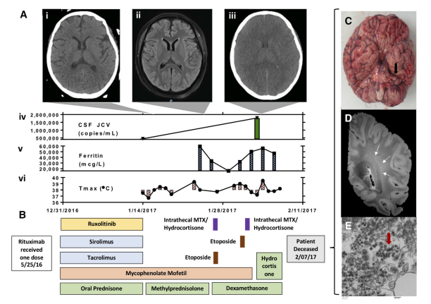
Notes:
We present an HIV-negative patient who developed aphasia and cognitive dysfunction with brain lesions that were initially restricted to the hemispheric cortex. Histological analysis showed the novel finding of productive JCV infection in cortical pyramidal neurons. Numerous astrocytes and neurons in the cortex of both cerebral hemispheres and at the graywhite junction and are infected by JCV.
Typical appearance of giant, bizarre astrocytes with multiple nuclei (arrrows) located in proximity to a neuron with an enlarged nucleus and marginated chromatin (arrowhead). (B) Cortical pyramidal neurons harboring atypical nuclei 5 to 6 times their normal size with central clearing of the chromatin (arrows) are interspersed among unaffected cells
PAPER 2
The clinical course consisted of progressive cortical suppression culminating in global cerebral edema with postmortem 7T MRI identifying no white matter lesions typical of JC viral infection. Histology confirmed JCV VP1 predominantly in glial cells, and hippocampal and cortical neurons. These results suggest a form of JCV encephalopathy without white matter lesions, even in advanced disease, which has not previously been reported.
Timeline of clinical course and postmortem JC virus (JCV) findings. (A) Serial brain imaging over hospital course, showing in vivo imaging and time-course of lab results: (i) computed tomography (CT) of the head with no pathologic changes, (ii) T2 fluid-attenuated inversion recovery magnetic resonance imaging (MRI) with no obvious abnormalities, (iii) CT of the head demonstrating global cerebral edema and loss of gray–white differentiation, (iv) cerebrospinal fluid (CSF) JC viral load, (v) plasma ferritin, and (vi) fever course throughout hospitalization. (B) Timeline of immunosuppressive therapies received by the patient from prior to hospitalization until death. MTX is defined as methotrexate (C) Postmortem brain with evidence of diffuse edema and tonsillar herniation (arrow). (D) Postmortem 7T MRI T2*-weighted imaging demonstrating hazy hyperintensity (arrows) in the periventricular white matter, likely due to diffuse brain edema. (E) Electron microscopy of postmortem frontal lobe tissue demonstrating ~40nm viral inclusions within the endoplasmic reticulum, characteristic of polyomavirus infection.

Slide 18
PML-IRIS (SIRI-LEMP)
PML-imune reconstitution inflammatory syndrome
HAART-era
Infiltrado inflamatório variável, predominantemente CD8+
Destruição tissular associada (variável)
Inclusões virais podem estar ausentes (assim como no burnt-out da LEMP)
Pode estar associada a outros estados imunossupressivos

Slide 19
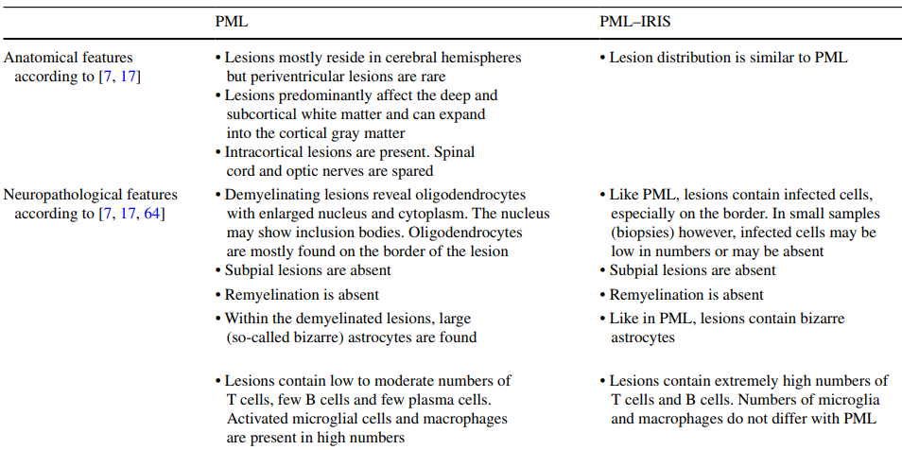
Bauer J et al. Progressive multifocal leukoencephalopathy and immune reconstitution inflammatory syndrome (IRIS). Acta Neuropathol. 2015

Slide 20
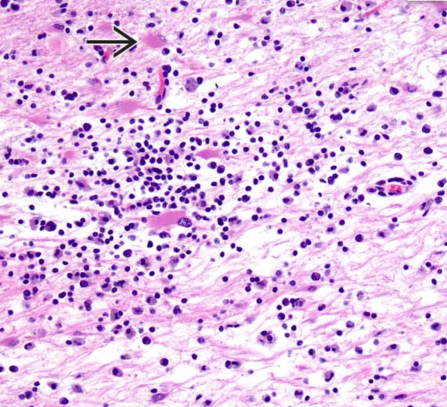
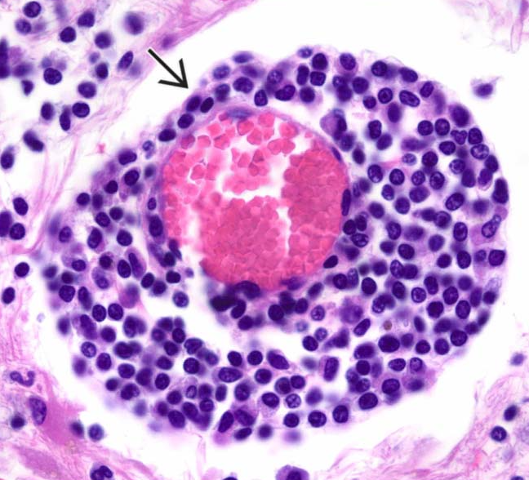
Diagnostic Pathology: Neuropathology, Third edition. 2022
Notes:
Infiltrado, astrocitos reacionais (setas), destruição tissular
Cuff perivascular, pode conter plasmocitos (seta) – area de predominancia

Slide 21
HIV-CD8E
Infiltração do parênquima por células T CD8+, predominando em substância branca
Acometimento meníngeo
Possível associação com infecção secundária, interrupção de HAART, IRIS; possível sobreposição com HIVE
Pode apresentar progressão rápida com edema difuso
Associação com EBV?
Notes:
HIV-associated CD8-encephalitis

Slide 22
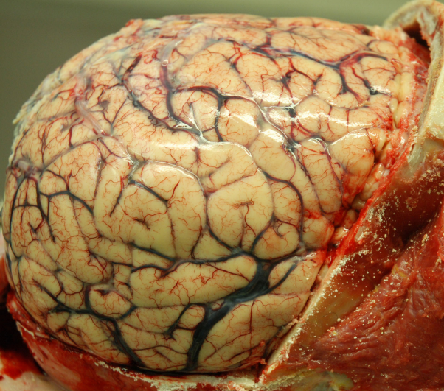
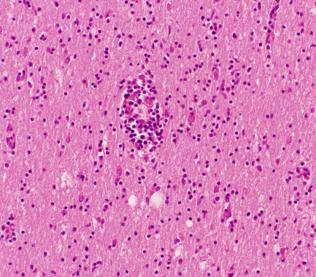
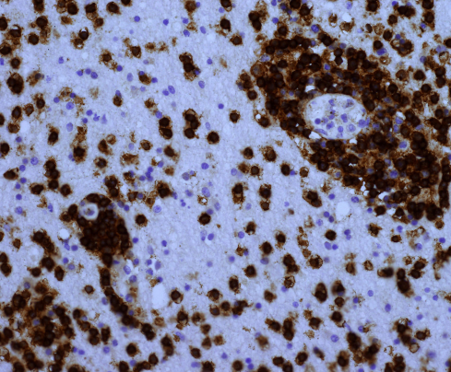
Lucas SB et al. HIV-Associated CD8 Encephalitis: A UK Case Series and Review of Histopathologically Confirmed Cases. Front Neurol. 2021
CD8
Notes:
Edema
Infiltrado predominantemente perivascular (área comum)

Slide 23
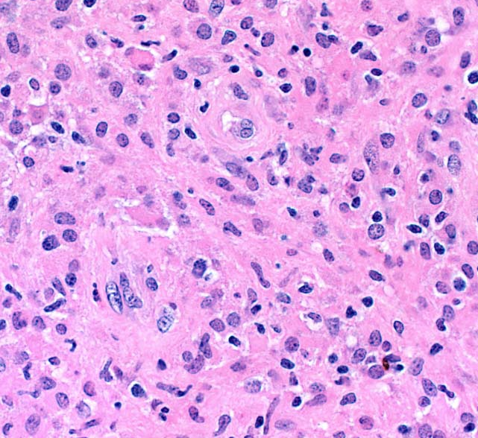
Mycobaterium avium-intracellulare complex (MAC)
Meningite, meningoencefalite
Granulomas esparsos, necrose pouco evidente/ausente
Spindle Cell Pseudotumor
Base dural (meningioma-like)
Histiócitos epitelioides
Grande número de microorganismos
Diagnostic Pathology: Neuropathology 3th edition
Notes:
sheets of epithelioid histiocytes and contained innumerable M. avium-intracellulare
Resposta “menos granulomatosa”

Slide 24
ARBOVIROSES

Slide 25
Arboviroses
“Arthropod-borne viruses”
Famílias:
Togaviridae (gênero alphavirus)
Flaviviridae
Bunyaviridae
Reoviridae
Mais comumente como encefalite

Slide 26
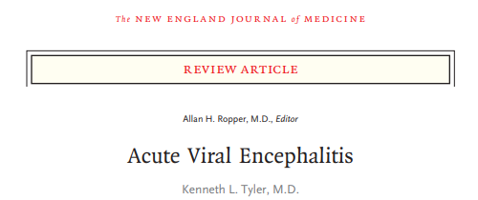
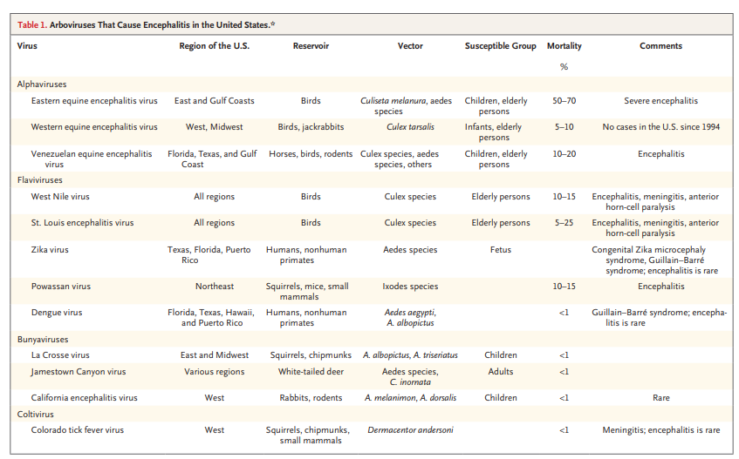
Chikungunya
YFV
Oropouche

Slide 27
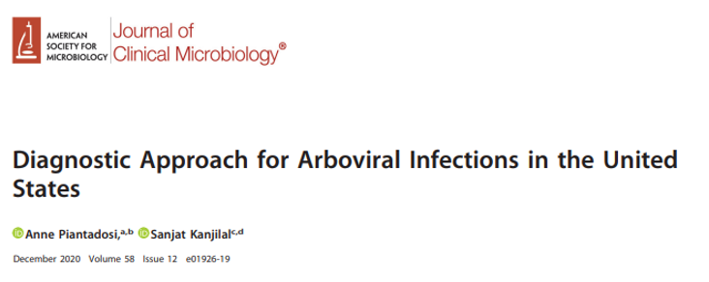
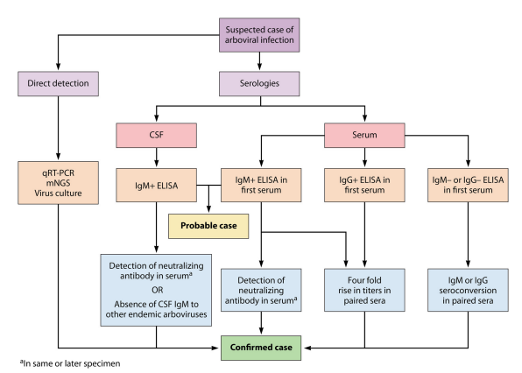
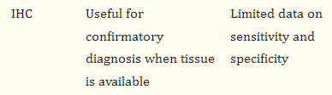
The CDC laboratory criteria for arboviral
infection require direct detection of virus
by culture, antigen, or nucleic acid

Slide 28
Chikungunya
“to walk bent over”, “stooped walking position”
Chikungunya vírus (CHIKV): tropismo por células gliais, menor por neurônios
Sinais e sintomas neurológicos frequentes, geralmente no início da doença – “case series during epidemics have reported neurologic involvement ranging from 0.1% to 16.3%. A neurological disorder was the primary issue in 61% and 79% of more severely affected patients in intensive care units” (McEntire CRS et al. Neurologic Manifestations of the World Health Organization's List of Pandemic and Epidemic Diseases. Front Neurol. 2021)
Notes:
Curvado em swahili

Slide 29
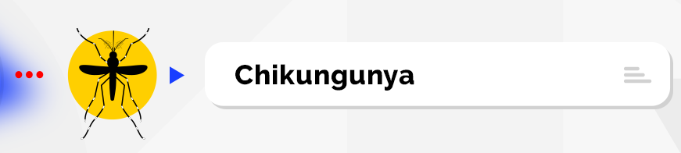
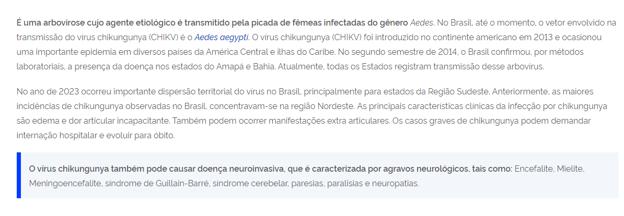
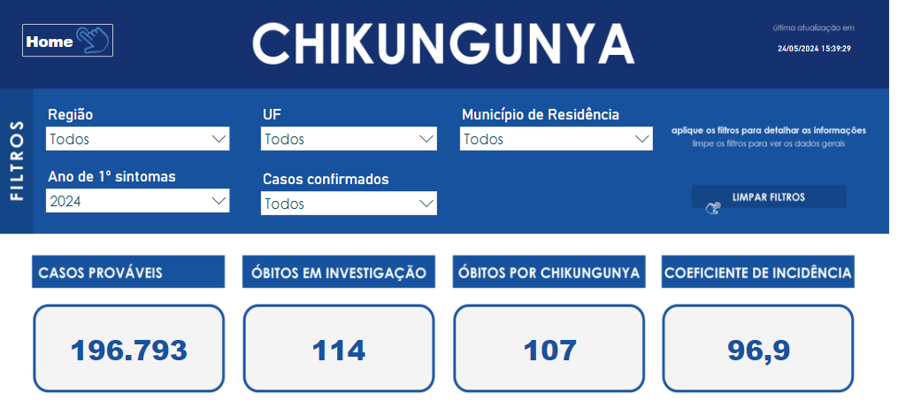
https://www.gov.br/saude/pt-br/assuntos/saude-de-a-a-z/c/chikungunya.html.
Consultado em 27 de Maio de 2024.

Slide 30

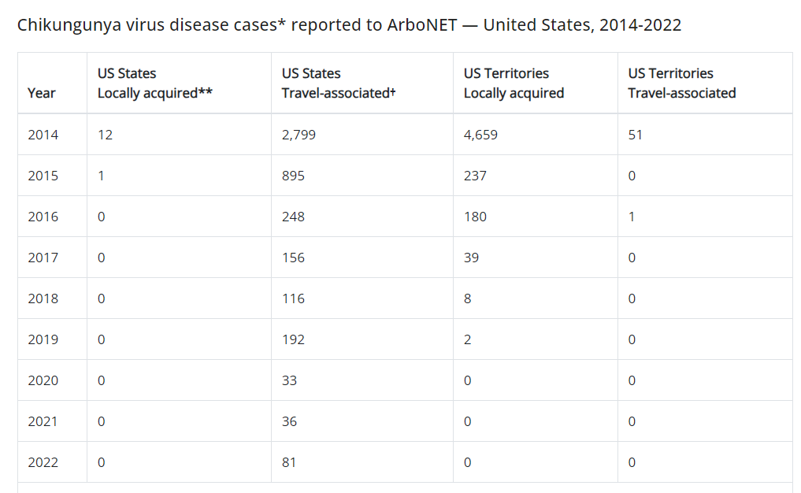
https://www.cdc.gov/chikungunya/index.html. Consultado em 23 de Maio de 2024.

Slide 31
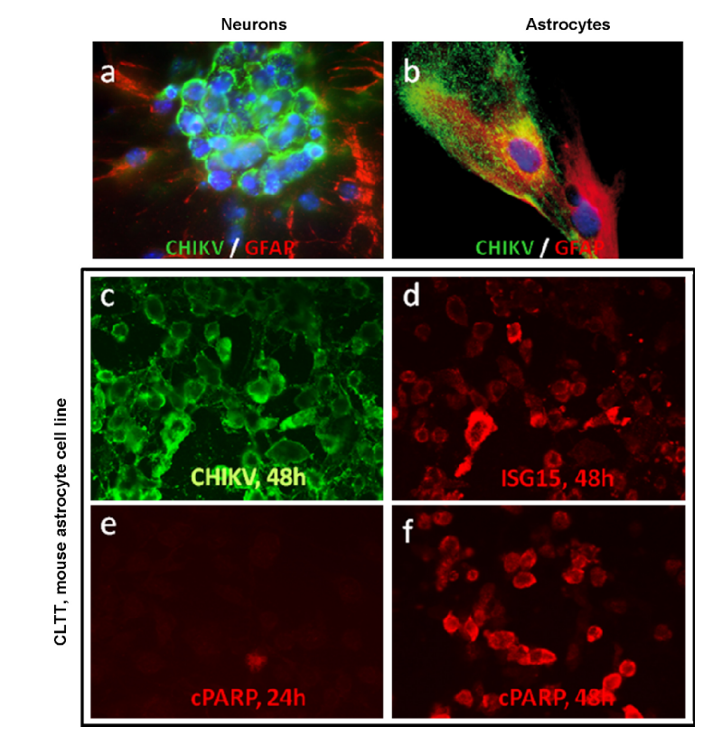
Das T et al. Chikungunya fever: CNS infection and pathologies of a re-emerging arbovirus. Prog Neurobiol. 2010.
Notes:
CHIKV infection and replication in neurons and astrocytes drive programmed cell death and innate immunity. Cells were either mock-infected or infected for 24–48 h with CHIKV (MOI of 1). Cells were then double stained using antibodies against CHIKV (in green), markers of astrocytes (GFAP, red), of neurons (Tuj1, not shown), markers of innate immunity (ISG15, in red), or markers of late apoptosis (cleaved PARP, in red). Of note, none of these antibodies stained mock-infected cells (not shown). (a) Cluster of mouse embryonic neurons (E16–19) were strongly stained for CHIKV. (b) Primary astrocytes from 1- to 2-day-old mice were stained for CHIKV. CHIKV infection was also evidenced in the CLTT mouse astrocyte cell line model stained for CHIKV (c), ISG15 (d), and cleaved PARP (e–f).

Slide 32
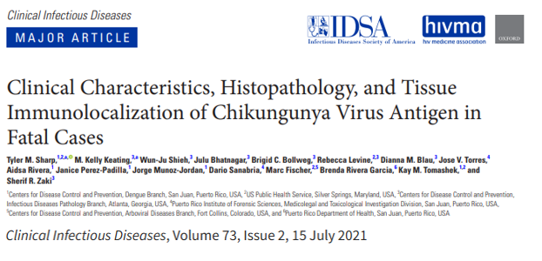
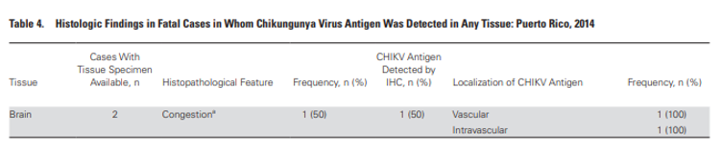
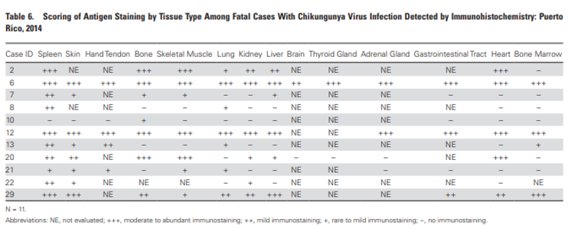

Slide 33
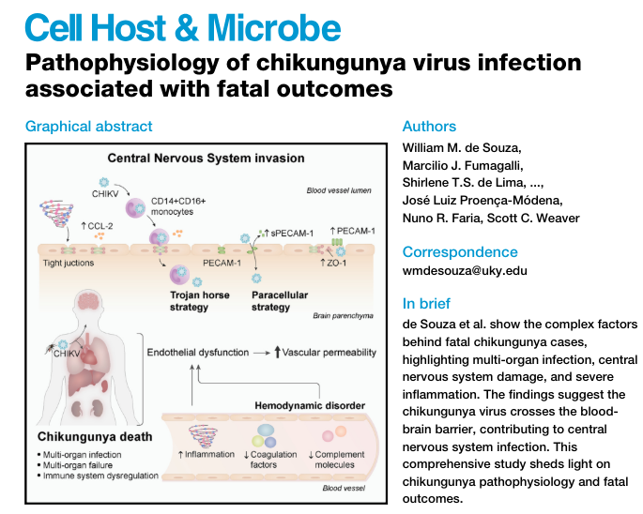
Ruptura da BHE e transmigração viral

Slide 34
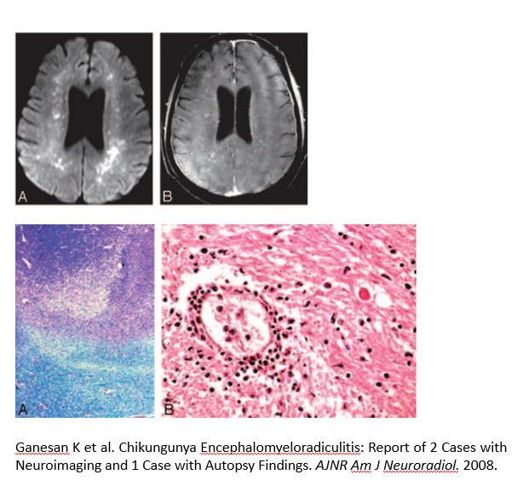
Achados Histopatológicos
Edema
Hemorragias subaracnóideas
Infiltrado inflamatório predominantemente perivascular
Focos de necrose
Focos de desmielinização
Reatividade microglial discreta
Notes:
A, Bilateral frontoparietal white matter lesions with restricted diffusion. B, Postcontrast enhancement on T1WI fat-saturated images and mild ventriculomegaly
Fig 2. A, Foci of demyelination in subcortical white matter (Luxol Fast Blue stain, 20). B, Perivascular lymphocytic basal ganglia infiltrates (H&E stain, 20).

Slide 35
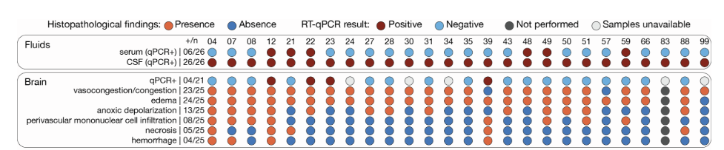
(…) histopathological findings of CHIK-death cases revealed extensive damage in the brain (e.g., anoxic depolarization, perivascular mononuclear infiltration, necrosis, and hemorrhage), and hemodynamic abnormalities (e.g., vascular congestion and edema)
Souza WM et al. Cell Host Microbe. 2024.
Notes:
Óbitos por CHIKV

Slide 36
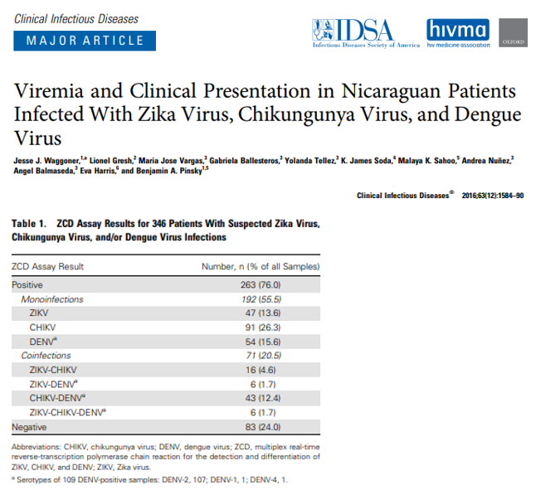
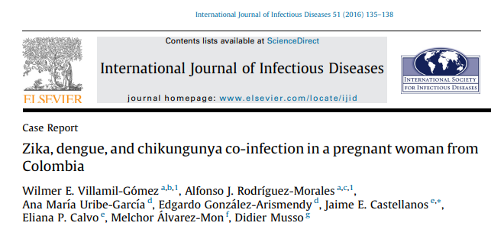
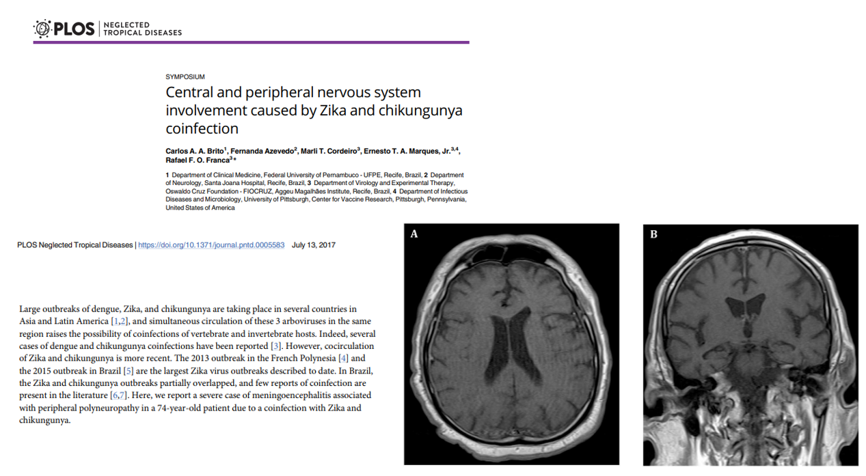

Slide 37
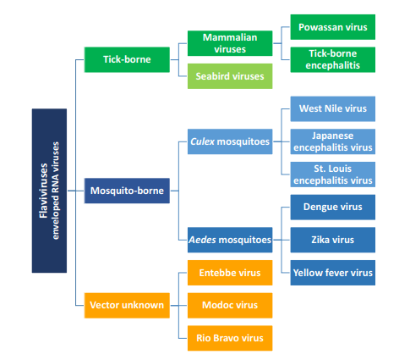
Hale GL. Flaviviruses and the Traveler: Around the World and to Your Stage. A Review of West Nile, Yellow Fever, Dengue, and Zika Viruses for the Practicing Pathologist. Mod Pathol. 2023

Slide 38
Dengue
DENV 1-4 (sorotipos 2 e 3 mais associados a alterações do sistema nervoso)
Segunda doença transmitida por mosquitos mais prevalente no mundo (malária – 1°)
“Dengue can manifest with a wide range of neurological features, which have been noted—depending on the clinical setting—in 0∙5–21% of patients with dengue admitted to hospital” (Carod-Artal FJ et al. Neurological complications of dengue virus infection. Lancet Neurol. 2013)

Slide 39
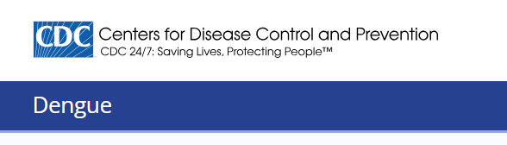
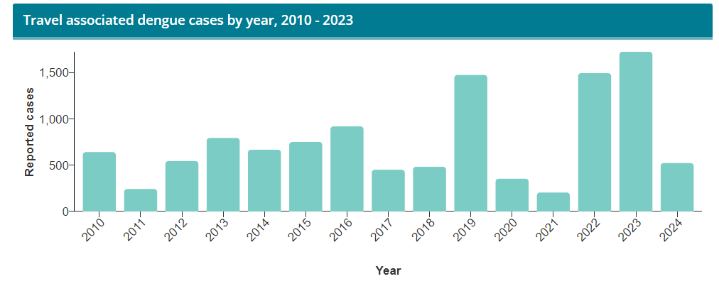
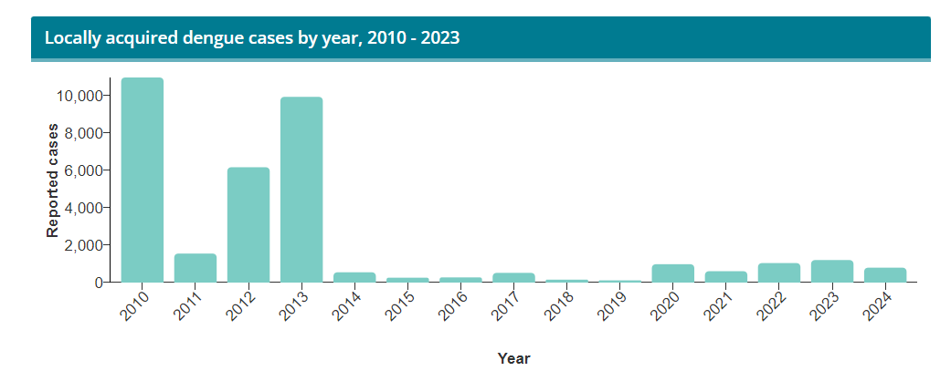
https://www.cdc.gov/dengue.html. Consultado em 10 de Maio de 2024.

Slide 40
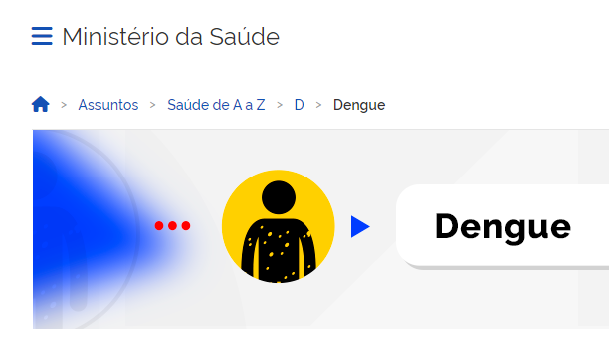
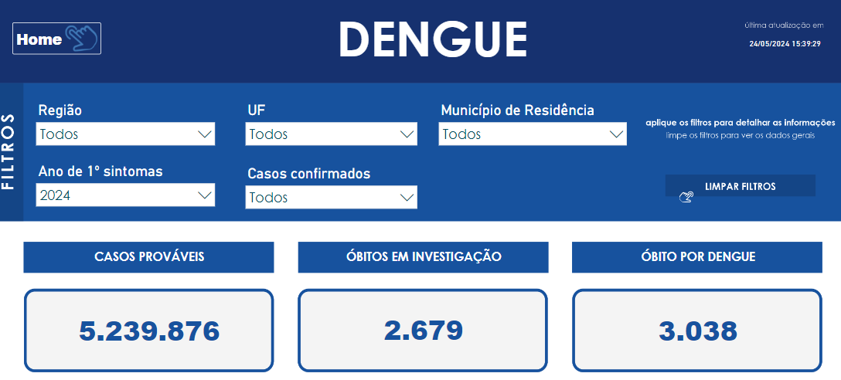
https://www.gov.br/saude/pt-br/assuntos/saude-de-a-a-z/a/aedes-aegypti/monitoramento-das-arboviruses. Consultado em 27 de Maio de 2024.

Slide 41
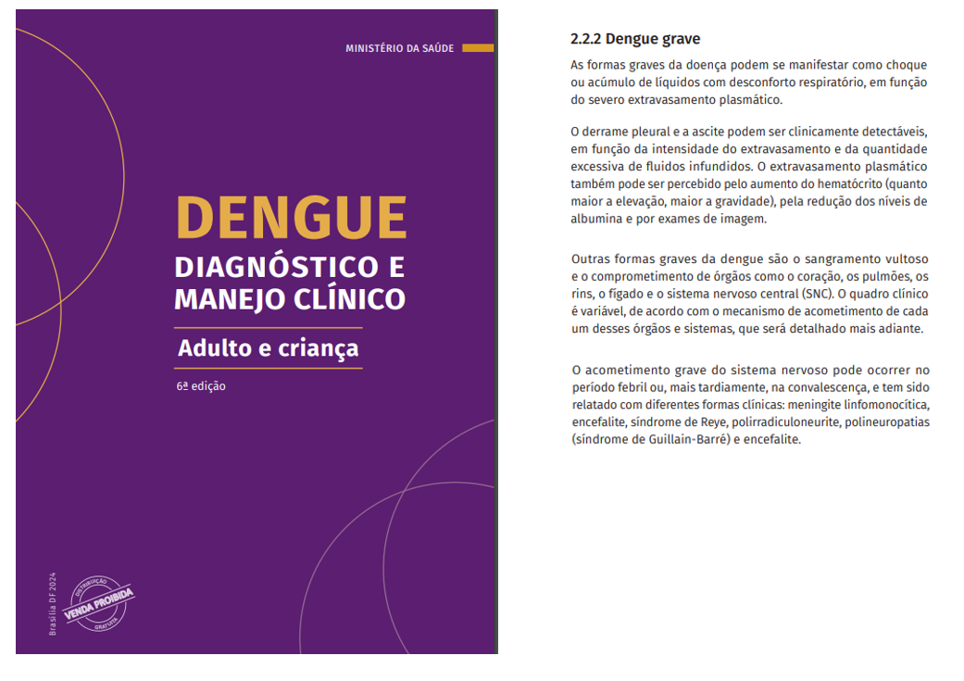

Slide 42
Neuropatogênese
The neuro-pathogenesis of DENV infection remains poorly understood. Both viral and host factors probably play important roles in the genesis of dengue-related neurological syndromes. Three mechanisms may be operative: direct CNS invasion by the virus, autoimmune reactions, and metabolic alterations. Although DENV has traditionally been considered to be non-neurotropic, neurological involvement, demonstration of CSF viral particles, and damage to the BBB, all seem to be suggestive of direct viral neurotropism
(Trivedi S, Chakravarty A. Neurological Complications of Dengue Fever. Curr Neurol Neurosci Rep. 2022)
Alterações associadas a distúrbios metabólicos – encefalopatia
Alterações associadas a infecção direta – encefalite, meningite, miosite, mielite
Alterações associadas a reatividade imune – encefalomielite aguda disseminada (ADEM), Guillain-Barré

Slide 43
Neuropatogênese
Disseminação hematogênica
Dano à BHE como mecanismo mais importante das alterações
Trabalhos mostrando infecção de células endoteliais, neurônios, células gliais, e micróglia – liberação de mediadores inflamatórios, morte celular, repositório viral (injúria tardia - micróglia)
(Calderón-Peláez MA et al. Dengue Virus Infection of Blood-Brain Barrier Cells: Consequences of Severe Disease. Front Microbiol. 2019)

Slide 44
Achados Neuropatológicos
Edema, podendo ser maciço e estar associado a herniação
Congestão meníngea e parenquimatosa
Hemorragia meníngea e parenquimatosa variável em extensão (dano endotelial, degeneração da parede vascular, distúrbios da coagulação)
Eventos isquêmicos – algumas descrições
Infiltrado inflamatório perivascular, algumas descrições de acometimento do parênquima
Morte neuronal, reatividade glial
Meningite e mielite geralmente caracterizadas por análise do LCR, não AP

Slide 45
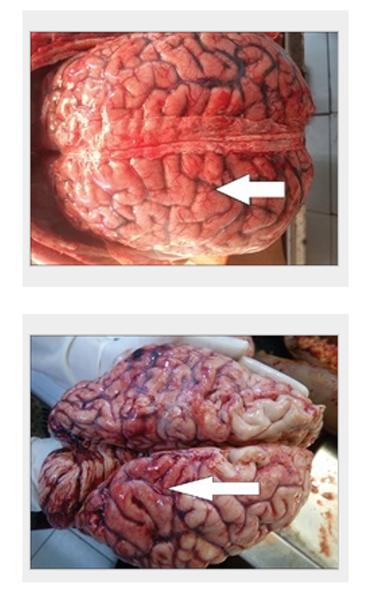
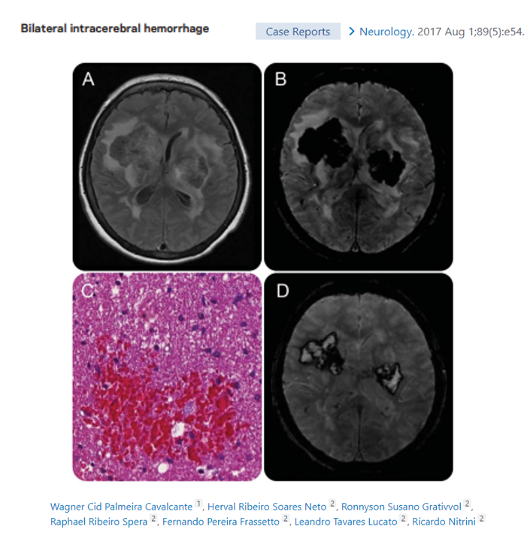
Jois D et al. Autopsy in dengue encephalitis: An analysis of three cases. Neurol India. 2018
Notes:
Edema, hemorragia

Slide 46
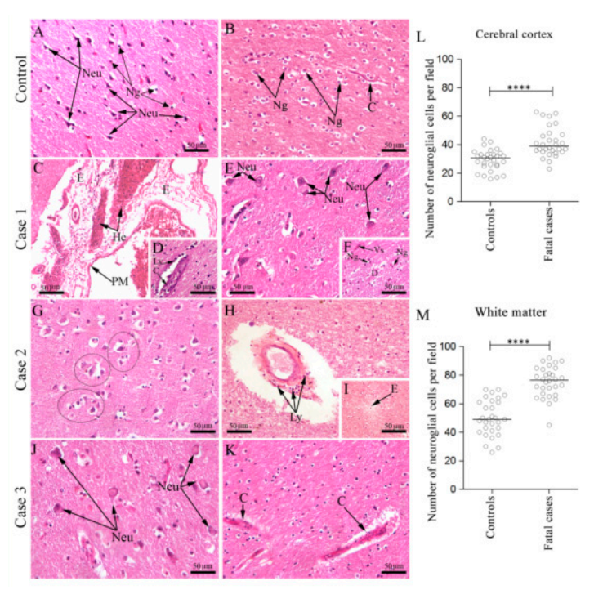
Salomão N et al. Fatal Dengue Cases Reveal Brain Injury and Viral Replication in Brain-Resident Cells Associated with the Local Production of Pro-Inflammatory Mediators. Viruses. 2020.
Notes:
Histopathological analysis of the brain. (A) Cortical area of a non-dengue case with regular neurons and neuroglial cells; (B) White matter of a non-dengue fatal case with regular neuroglial cells and capillary; (C) Brain section of case 1 exhibited edema and hemorrhage areas in the pia-matter, (D) numerous mononuclear cells in the capillaries; (E) perineuronal vacuolation, (F) demyelination areas with presence of neuroglia cells; (G) Brain section of case 2 showing many “cuffs” of degenerated neurons and neuroglia cells, (H) lymphocytic cells infiltrate around of capillaries, (I) and edema; (J) Brain section of case 3 exhibiting intense neuronal degeneration (K) and thickening of the basement membrane of capillaries. (L,M) Neuroglial cells quantification assessed by Mann–Whitney U test, in the cortex and the white matter, respectively. Asterisks indicate statistically significant differences between samples: *** p < 0.0001. Cortical area (A,E,G,J) and white matter area (B–D,F,H,I,K). WM—White matter, Cc—Cerebral cortex, C—Capillary, PyN—Pyramidal neurons, Neu—Neuron, E—Edema, He—Hemorrhage, Ly—Lymphocytes, D—Demyelination, Vs—Vessel, Ng—Neuroglia, Black circles—“cuffs” of neurons and microglia

Slide 47

Salomão N et al. Viruses. 2020.
Notes:
DENV antigen detection in the brain of fatal cases. (A) Brain tissue of a non-dengue case and (B) dengue case incubated only with secondary antibody; (C) Brain tissue of a non-dengue case incubated with primary and secondary antibodies; Detection of DENV antigen in: (D) neurons and microglial cells of case 1; (E) in Purkinje neurons (F) and microglia of case 2; (G) in microglia (H) and endothelial cells of case 3. Neu—Neuron, Mi—Microglia, EC—Endothelial cells, PN—Purkinje neuron.
To verify viral replication in brain resident cells, we proceeded with immunostaining of the NS3 protein, a non-structural viral protein which actively participates in viral replication. NS3 antigen was detected in a broad range of cell types which included pyramidal neurons (Figure 4B), endothelial cells (Figure 4D,F), Purkinje neurons (Figure 4E), macrophages (Figure 4F), and microglia (Figure 4C,G). In a third approach, we used the in situ hybridization technique to confirm DENV replication, which was assessed using a probe which anneals in a conserved region within the NS3 gene in the negative strand of DENV RNA. Through this technique, replication of the DENV RNA was evidenced in neurons, endothelial cells, microglia cells (Figure 4I), and Purkinje neurons (Figure 4J). As expected, any detection was observed in samples of non-dengue cases (Figures 3A and 4A,H
Detection of NS3 protein in the brain tissue of fatal cases. (A) Immunoperoxidase technique. Brain of a non-dengue case without NS3 detection; (B) Detection of DENV-NS3 protein in pyramidal. neurons and (C) microglia of the white matter in case 1; (D) in endothelial cells and (E) Purkinje neuron in case 2; (F) in endothelial cells and macrophages (G) and microglia in granular layer of case 3; (H) Hybridization in situ technique—brain of a non-dengue case; (I) Detection of DENV RNA negative strand in neurons, endothelial cells, microglial cells in case 2 (J) and Purkinje neurons in case 3. Neu—Neuron, Mi—Microglia, EC—Endothelial cells, Mo—Macrophages, PyN—Pyramidal neurons, PN—Purkinje
TAMBÉM PODE SER FEITO RT-PCR, P. EX.

Slide 48
Dengue e Músculo Esquelético
Poucas descrições histopatológicas
- Infiltrado inflamatório linfomononuclear perivascular e intersticial
- Fibras necróticas com evidência de regeneração
- Miofagocitose

Slide 49

West Nile Virus
Principal causa de encefalite viral mundial (mas menos de 1% das infecções resultando em neuroinvasão)
Encefalopatia, sinais meníngeos, paralisia aguda flácida, neurite, miosite, Guillain-Barré
Primeiro caso de encefalite em humanos no Brasil detectado em 2014

Slide 50






Slide 51
COVID-19

Slide 52
COVID-19
SARS-CoV-2
Sinais e sintomas neurológicos (incluindo nervos cranianos – anosmia, ageusia - e periféricos) geralmente presentes e precoces
Alterações cognitivas persistentes – “COVID fog”
Notes:
PERDA DE PALADAR

Slide 53
COVID-19 e Sistema Nervoso
Processos trombóticos: trombose de seio venoso, infarto isquêmico
Processos associados a disfunção endotelial: hemorragias, síndrome da encefalopatia posterior reversível
Processos associados a hipoperfusão: infartos “watershed”, leucoencefalopatia
Processos associados a inflamação: encefalite aguda hemorrágica, encefalite, vasculite-like, doença desmielinizante pós-infecciosa
Patogênese das diversas condições intimamente relacionada – ativação inflamatória associada a lesão vascular, e danos vasculares associados a inflamação

Slide 54



Slide 55
Cosentino G et al. 2021
Detection rates of SARS-CoV-2 RNA and proteins did not differ between COVID-19 patients with versus those without neurological symptoms. This first finding is in line with the prevailing hypothesis that, in most subjects, neurological symptoms associated with COVID-19 do not arise from direct cytopathic effects mediated by SARS-CoV-2 (…)
Of relevance, the relatively low identification rates (about 42%) and the low levels of viral RNA cast doubt on the real presence of SARS-CoV-2 in the brain. It has been argued that detection of SARS-CoV-2 RNA in brain samples could derive from hematogenous viral RNA or viral contamination during different stages of the autopsy. This suggestion is further corroborated by the even lower detection rates of SARS-CoV-2 proteins (about 28%) as well as of viral RNA when using in situ hybridization, which is a more reliable detection technique with respect to the most widely used RT-PCR

Slide 56
COVID-19 e Sistema Nervoso
Detecção de proteínas e RNA viral inconsistente (IHC, HIS) e de validade discutível em vários estudos (Stein JA et al. Neuropathology in COVID-19 autopsies is defined by microglial activation and lesions of the white matter with emphasis in cerebellar and brain stem areas. Front Neurol. 2023)
From a neuropathological standpoint, our data suggest that SARS-CoV-2 slightly penetrates the brain, but does not actively replicate within it (…) Our data suggest that SARS-CoV-2 causes an acute infection with progressive “cleaning” of the virus from the affected tissues (Poloni ET et al. COVID-19 Pathology in the Lung, Kidney, Heart and Brain: The Different Roles of T-Cells, Macrophages, and Microthrombosis. Cells. 2022)

Slide 57
Achados Histopatológicos
Infiltrado inflamatório predominantemente linfocítico (células T) - perivascular, leptomeníngeo
Reatividade microglial, macrófagos perivasculares e em alguns casos formando clusters em parênquima (principalmente substância branca – Stein JA et al. 2023) – ativação microglial/macrofágica (semelhante a alterações associadas ao vírus Influenza)
Neuroanatomical localization of described lesions could explain some “post COVID symptoms”: Intense microglial-macrophage activity in nuclei and white matter of the cerebellum are likely cause of dizziness. Extensive microgliosis in the brain stem, possibly in important control centers of arousal and consciousness like the reticular formation, might explain difficulty in concentration in many reported “long COVID” patients with chronic fatigue (Stein JA et al. 2023)

Slide 58



Diagnostic Pathology: Neuropathology, Third edition. 2022

Slide 59


Yang AC et al. Dysregulation of brain and choroid plexus cell types in severe COVID-1. Nature. 2021

Slide 60

“SARS-CoV-2 does not invade the brain in
the majority of cases and so the associated neurological complications might arise
from indirect effects, such as
immune activation (…)
It is becoming clear that the majority of neurological complications involve neuroinflammation (…)
elevated cytokines, blood-brain barrier
damage, immune infiltration, blood vessel inflammation, and blood vessel blockage
leading to hypoxia, as well as
immune-mediated tissue damage mediated
by cells and/or autoantibodies.”
(Dunai C et al. Immune-Mediated Mechanisms of COVID-19 Neuropathology. Front Neurol. 2022)

Slide 61

We demonstrated increased levels of brain injury markers following COVID-19 (…) In the acute phase, all four brain injury markers (GFAP, NfL, tTau and UCH-L1) were elevated in participants when compared to controls, and specific markers of dendritic and axonal injury (tTau and NfL) were significantly higher in participants who showed a reduced level of consciousness (GCS ≤ 14). In the early convalescent phase (6 weeks) elevations of NfL and GFAP were only seen in participants who had sustained a neurological complication of COVID-19 in the acute phase of their illness. These data suggest that clinical neurological dysfunction in COVID-19 is reflected by increases in markers of neuroglial injury, both in the acute phase and at follow-up, which are related to a dysregulated immune response, more robustly in the acute phase of illness
Notes:
Parainfectious: Occurring at the time of and in association with an acute infection or an episode of infection.
GFAP (glial fibrillary acidic protein, marker of astrocyte injury), UCH-L1 (a marker of neuronal cell body injury), and NfL (neurofilament light) and Tau (both markers of axonal and dendritic injury) were measured.

Slide 62


Slide 63
Long COVID e Sistema Nervoso
Disfunção cognitiva (“COVID fog” – quadro semelhante ao associado com terapias imunes, “chemo fog”/cancer-therapy-related cognitive impairment), mesmo em infecções clinicamente leves
- Distúrbios de memória, funções executivas, atenção e velocidade de processamento de informações
- Fadiga
- Transtornos do humor

Slide 64




Slide 65
Fernández-Cast. A et al. 2022
Ativação microglial/macrofágica, elevação de CCL11 (entre outras citocinas)
Prejuízo à neurogênese e neuroplasticidade hipocampal
Redução dos precursores de oligodendrócitos, bem como de células maduras - desmielinização

Slide 66
Fernández-Cast. A et al. 2022
“Other respiratory viral infections such as influenza are also associated with cognitive and other neurological sequelae. The H1N1 strain of influenza (…) causes acute elevation in CNS cytokines, hippocampal microglial reactivity, and impaired performance in cognitive behavioral tests”
“A comparison of these cytokine profiles after mild respiratory infection with influenza or SARS-CoV-2 illustrates overlapping but distinct neuroinflammatory profiles, with the notable shared feature of persistently elevated CCL11”

Slide 67

Influenza (H5N1 principalmente, H1N1) – infecção de neurônios e micróglia, apoptose neuronal, ativação microglial e macrofágica, alterações persistentes em perfil de citocinas (mas...)
“COVID-19 is associated with a much higher rate of long-term symptoms than influenza (…) In addition, animal models also suggest that the two diseases impact different parts of the nervous system long-term (…) Therefore, while there are similarities between COVID-19 and influenza's long-term neurological sequelae, additional efforts will be needed to understand the differences”

Slide 68

Volk P et al. J Neurochem. 2023
Notes:
Peripheral inflammation leads to central nervous system dysfunction. Influenza, COVID-19, and other diseases outlined in Table 1 increase peripheral inflammation. This involves the release of cytokines and chemokines into the circulation, and immune cell modulation. These peripheral events culminate in blood–brain–barrier dysfunction, characterized by “leaky” vasculature enabling invasion of inflammatory molecules and cells into the central nervous system. Astrocytes and microglia are modulated by these inflammatory stimuli, thus changing their morphology and function, in a process previously known as gliosis. These modulated glial cells can further exacerbate the immune response by releasing cytokines, chemokines, and reactive oxygen species (ROS), which together may result in loss of neurons and/or synapses, leading to cognitive impairment and other forms of neurological dysfunction

Slide 69
Take Home Messages
Infecções virais são um desafio constante em neuropatologia
HIV/AIDS (pandemia): não só alterações relacionadas à infecção viral e imunocomprometimento, mas também à HAART
Arboviroses: importante causa de morbidade e mortalidade, com sintomatologia e achados morfológicos muitas vezes sobreponentes/inespecíficos, e com intervenções preventivas e terapêuticas muitas vezes limitadas
COVID-19 (e outros vírus respiratórios): possíveis danos persistentes aos sistema nervoso, necessidade de acompanhar em longo prazo os indivíduos afetados

Slide 70


Questões?

Slide 71
MUITO OBRIGADO!

